Slide 1
Behavioral Patterns
JS Patterns and Anti Patterns
Malte Brockmann, Jun Heui Cho

Slide 2
Outline
Behavior pattern in general
Command
Memento
Chain of responsibility
Observer
Summary

Slide 3
Behavior Pattern in general
Mainly concerned with the communication between objects.
Describe a process or a flow
encapsulating behavior and delegating of requests
increases flexibility

Slide 4
Command
Encapsulate a request as an object
Request without knowing anything about the operation being requested. - “Black box execute()”
Uses: GUI buttons, Networking, Multi-level undo, Progress bar

Slide 5
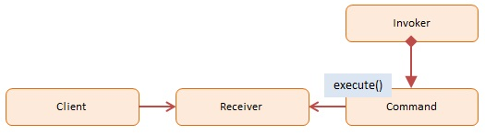
Command - Participants
Client: decides which command at which point
Receiver: knows how to carry out the operation
Command: execute()
Invoker: knows how to execute
http://www.dofactory.com/images/diagrams/javascript/javascript-command.jpg

Slide 6
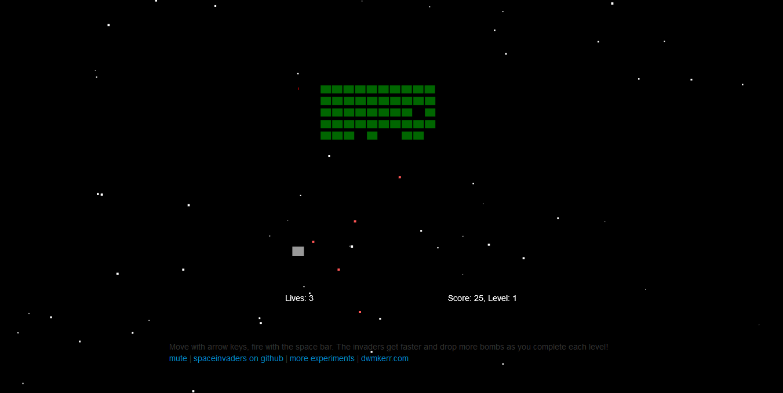
Spaceinvader
Retro Game: shooting Spaceinvader
Level bases
State bases (Welcome-, GameOver-, PlayState, ect.)

Slide 7
Command - Spaceinvader 1/4
old
new
before:
if(game.pressedKeys[37]) {
this.ship.x -= this.shipSpeed * dt; //dt = Delta time
} // = 1/fps
if(game.pressedKeys[39]) {
this.ship.x += this.shipSpeed * dt;
}
if(game.pressedKeys[32]) {
this.fireRocket();
}
[…]
bomb.y += dt * bomb.velocity;
[…]
rocket.y -= dt * rocket.velocity;

Slide 8
Command - Spaceinvader 2/4
old
new
after: (Commands)
var goLeft = {
execute : function(obj, speed) {
obj.x -= speed * dt;
}
}
var goRight = {
execute : function(obj, speed) {
obj.x += speed * dt;
}
}
var shoot = {
execute : function(obj) {
obj.fireRocket();
}
}

Slide 9
Command - Spaceinvader 3/4
old
new
after: (Commands)
var goUp = {
execute : function(obj, speed) {
obj.y -= speed * dt;
}
}
var goDown = {
execute : function(obj, speed) {
obj.y += speed * dt;
}
}

Slide 10
Command - Spaceinvader 4/4
old
new
after:
//The Client is the main loop and the invoker is the user
if(game.pressedKeys[37]) { //<-receiver
goLeft.execute(this.ship, this.shipSpeed);
}
if(game.pressedKeys[39]) {
goRight.execute(this.ship, this.shipSpeed);
}
if(game.pressedKeys[32]) {
shoot.execute(this);
}
[…]
goDown.execute(bomb, bomb.velocity);
[…]
goUp.execute(rocket, rocket.velocity);

Slide 11
Memento
Capturing and externalizing an object’s internal state to be restored later.
Database of “save point”
Use: used to avoid disclosure of implementation details

Slide 12
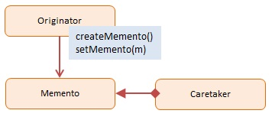
Memento - Participants
Originator: interface to create and restore mementos
Memento: ordinator object
Caretaker: stores mementos
http://www.dofactory.com/images/diagrams/javascript/javascript-memento.jpg

Slide 13
Memento - Spaceinvader 1/4
old
new
before:
WelcomeState.prototype.keyDown = function(game, keyCode) {
[…]
game.moveToState(new LevelIntroState(game.level));
};
[…]
GameOverState.prototype.keyDown = function(game, keyCode) […]
game.moveToState(new LevelIntroState(1));
}

Slide 14
Memento - Spaceinvader 2/4
old
new
after:
function Memento(state){
this.state = state;
this.getSavedState = function(){
return this.state;
};
};
function Caretaker(){
var saveState = [];
this.addMemento = function(memento){
saveState.push(memento);
};
this.getMemento = function(index){
return saveState[index];
};
};

Slide 15
Memento - Spaceinvader 3/4
old
new
after:
//In this case an Originator is for example a LevelIntroState
caretaker = new Caretaker();
[…]
WelcomeState.prototype.keyDown = function(game, keyCode) {
[…]
caretaker.addMemento(new Memento(new LevelIntroState(game.level)));
game.moveToState((caretaker.getMemento(0)).getSavedState());
};
[…]
GameOverState.prototype.keyDown = function(game, keyCode) {
[…]
game.moveToState((caretaker.getMemento(0)).getSavedState());
};

Slide 16
Memento - Spaceinvader 4/4
getMemento(0)
Game
Caretaker
WelcomeState
new created
moveToState( )
Memento
LevelIntroState
LevelIntroState
Memento
GameOverState
...
moveToState( )
LevelIntroState

Slide 17
Chain of responsibility
Avoid coupling between the sender and the receiver of a request.
More than one object have the chance to handle the request.
linear search for a handler

Slide 18

Chain of responsibility - Participants
Client: initiator of the request
Handler: has an interface for handling the request
http://www.dofactory.com/images/diagrams/javascript/javascript-chain-of-responsibility.jpg

Slide 19
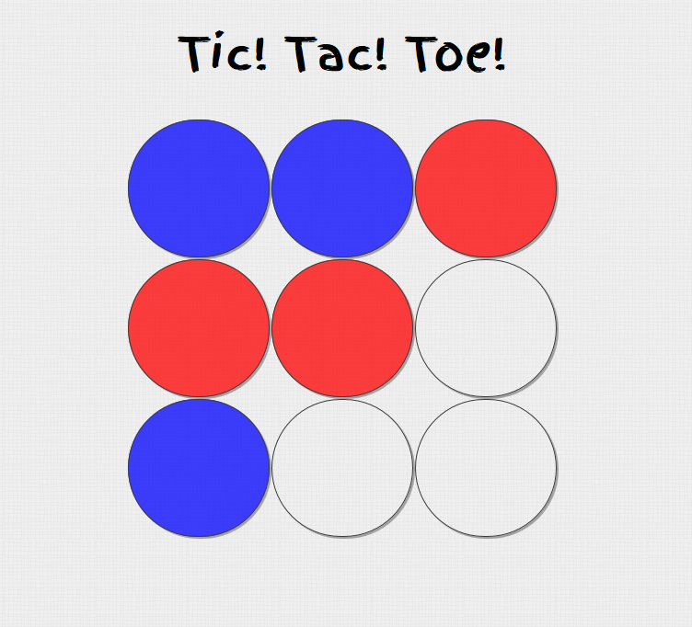
Tic Tac Toe
retro Game
2 player
checks winner or tie after each turn
restarts

Slide 20
Chain of responsibility - Tic tac toe 1/7
old
new
before:
function checkWinner() {
if (checkRows() === true || checkCols() === true || checkDiag() === true) {
winningPlayer = turn.currentPlayerColor();
// Alert winner
endGame("Player " + winningPlayer + ", you win!");
}
else if (checkTie() === true) {
endGame("It's a tie...");
}
else {
turn.changeTurn();
}
}

Slide 21
Chain of responsibility - Tic tac toe 2/7
old
new
before:
function checkRows() {
for (i = 0; i < board.length; i++) {
var same = true;
for (j = 0; j < board[i].length; j++) {
if (board[i][j] === 0 || board[i][j] !== board[i][0]) {
same = false;
}
}
if (same) {
return same;
}
}
}

Slide 22
Chain of responsibility - Tic tac toe 3/7
old
new
before:
function checkTie() {
var flattenedBoard = Array.prototype.concat.apply([], board);
for(i = 0; i < flattenedBoard.length; i++){
if(flattenedBoard[i] === 0){
console.log(i);
return false;
}
}
return true;
}

Slide 23
Chain of responsibility - Tic tac toe 4/7
old
new
after:
function checkWinner() {
checkRows();
}

Slide 24
Chain of responsibility - Tic tac toe 5/7
old
new
after:
function checkRows() {
for (i = 0; i < board.length; i++) {
var same = true;
for (j = 0; j < board[i].length; j++) {
if (board[i][j] === 0 || board[i][j] !== board[i][0]) {
same = false;
}
}
if (same) {
winningPlayer = turn.currentPlayerColor();
// Alert winner
endGame("Player " + winningPlayer + ", you win!");
}
}
checkCols();};

Slide 25
Chain of responsibility - Tic tac toe 6/7
old
new
after:
function checkTie() {
var flattenedBoard = Array.prototype.concat.apply([], board);
for(i = 0; i < flattenedBoard.length; i++){
if(flattenedBoard[i] === 0){
console.log(i);
turn.changeTurn();
return;
}
}
endGame("It's a tie...");
}

Slide 26
Chain of responsibility - Tic tac toe 7/7
before:
after:
checkWinner()
checkWinner()
checkRows()
checkCols()
checkDiag()
endGame(“Player X, you win!”)
checkRows()
endGame(“Player X, you win!”)
checkTie()
endGame(“Player X, you win!”)
checkCols()
endGame(“Player X, you win!”)
checkDiag()
changeTurn()
endGame(It’s a tie...”)
checkTie()
endGame(It’s a tie...”)
changeTurn()

Slide 27
Observer
Define a one-to-many dependency between objects
When one object (Observable) changes its state, all dependent objects (Observers) are notified (usually with a message)
Notified objects handle their own update

Slide 28
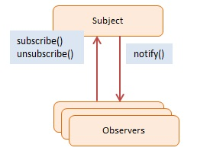
Observer - Participants
Subject / Observable: maintains a list of observers, lets them subscribe/unsubscribe, and notifies them about changes
Observers: has a function that can be invoked when notified
http://http://www.dofactory.com/images/diagrams/javascript/javascript-observer.jpg

Slide 29
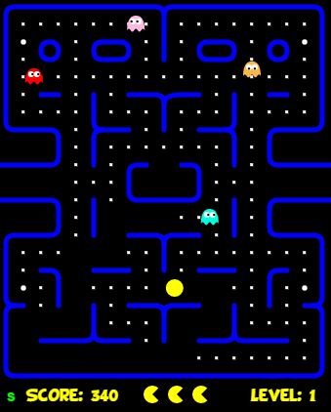
Pac Man
retro game (classic pacman)
3 lives
avoid getting eaten by ghosts
can eat and “jail” the ghosts for a short time after eating “beans”
eat all the blocks to a level

Slide 30
Observer – Pac Man 1/7
old
new
before:
function startLevel() {
user.resetPosition();
for (var i = 0; i < ghosts.length; i += 1) {
ghosts[i].reset();
}
audio.play("start");
timerStart = tick;
setState(COUNTDOWN);
}

Slide 31
Observer – Pac Man 2/7
old
new
before:
function eatenPill() {
audio.play("eatpill");
timerStart = tick;
eatenCount = 0;
for (i = 0; i < ghosts.length; i += 1) {
ghosts[i].makeEatable(ctx);
}
};

Slide 32
Observer – Pac Man 3/7
old
new
after:
function startLevel() {
user.resetPosition();
notifyObservers("levelstarted");
timerStart = tick;
setState(COUNTDOWN);
}
[…]
function eatenPill() {
timerStart = tick;
eatenCount = 0;
notifyObservers("pilleaten");
};

Slide 33
Observer – Pac Man 4/7
old
new
after:
//REFACTOR: adding observable functionalities
function subscribe(o) {
observers.push(o);
};
function unsubscribe(o) {
observers = observers.filter(
function(item) {
if (item !== o) { return item; } }
); };
function notifyObservers(message) {
for (var i = observers.length - 1; i >= 0; i--) {
observers[i].notify(message);
}; };

Slide 34
Observer – Pac Man 5/7
old
new
after:
//REFACTOR: subscribing ghosts and audio after creating
[…]
subscribe(ghost);
[…]
subscribe(audio);
[…]

Slide 35
Observer – Pac Man 6/7
old
new
after:
//REFACTOR: adding observer functionalities for Ghost
function notify(message) {
switch(message) {
case "levelstarted":
reset();
break;
case "pilleaten":
makeEatable();
break;
default:
break;
}
};
(Analog for Audio)

Slide 36
Observer – Pac Man 7/7
Observable
Observers
Game
subscribe()
Ghost
notify(msg)
startLevel()
notifyObservers(msg=„levelstarted“)
...
eatenPill()
notifyObservers(msg=„pilleaten“)
Audio
subscribe()
notify(msg)

Slide 37
Summary
Advantages of Behavioral Patterns:
Increase flexibility of programs
Well defined communication between objects (e.g. Observer)
Ability to extend programs easily
Simplify complex algorithms and control flows (e.g. Chain of Command)

Slide 38
Sources
http://www.dofactory.com/javascript/design-patterns
https://sourcemaking.com/design_patterns
http://www.blackwasp.co.uk/DesignPatternsArticles.aspx
https://en.wikipedia.org/wiki/Command_pattern
https://de.wikipedia.org/wiki/Memento_%28Entwurfsmuster%29
https://en.wikipedia.org/wiki/Chain-of-responsibility_pattern

Slide 39
Projects
Spaceinvader: https://github.com/dwmkerr/spaceinvaders
Tic Tac Toe: https://github.com/negomi/tic-tac-toe
Pacman: https://github.com/daleharvey/pacman

Slide 40
Iterator
access elements without knowing the underlying structure of the object
effectively loop over a object collection
object store as list, trees or more complex structures
many language have build in iterator, but not JavaScript
Iterator is the “secretary”

Slide 41
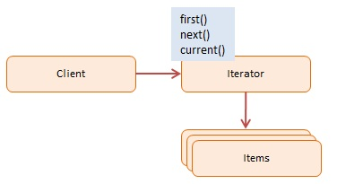
Iterator - Participants
Client: uses the iterator
Iterator: interface with methods like first(), next(), hasNext()
Items: individual objects
http://www.dofactory.com/images/diagrams/javascript/javascript-iterator.jpg

Slide 42
Strategie
Interchangeable set of algorithms
Swapped out at runtime
Minimizing coupling
Option to hide implementation

Slide 43
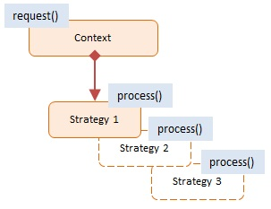
Strategie - Participants
Context: reference to the current Strategy, the option to change it and to calculate the “cost” of each strategy
Strategy: implementation of different option for a task
http://www.dofactory.com/images/diagrams/javascript/javascript-strategy.jpg

Slide 44
Template method
Outline of a series of steps for an algorithm
Subclasses can redefine certain steps of an algorithm without changing the algorithms structure
Offers extensibility to the client developer

Slide 45
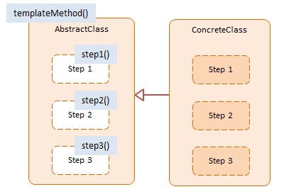
Template method - Participants
AbstractClass: template method defining the primitive steps for an algorithms
ConcreteClass: implements the primitive steps as defined
http://www.dofactory.com/images/diagrams/javascript/javascript-template-method.jpg

Slide 46
State
A object can alter its behaviour when its internal state changes
Object appears to have changed its class
E.g. state machines

Slide 47
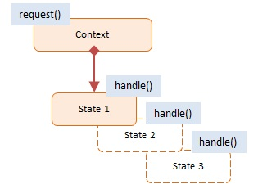
State - Participants
Context: maintains a reference to a object, defines its current state, and allows it to change its state
State: state values are associated with the according behaviour of the state
http://www.dofactory.com/images/diagrams/javascript/javascript-state.jpg

